Slide 1
Jumpstart your Writing:
Finding and Evaluating Academic Source Material

Slide 2

Successful Writers Read
Best way to improve as a writer is to read!
But what to read? Depends on what you want to write!
For academic writing, find scholarly works related to your topic

Slide 3
Benefits of Reading First
Begin to detect patterns in the literature
  How do other authors approach topics?
Learn jargon
  What terms are commonly used?
Your writing will slowly begin to emulate what you read.

Slide 4
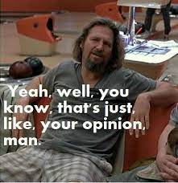
Benefits of Reading First
Find data that backs up your claims!
Without data, anything you claim in your writing is just opinion
Analytical writing is based on facts!

Slide 5
Types of Scholarly Works
Book Chapters
Interviews
Websites
Journal articles
Important! Make sure to properly cite any works you borrow from (more on that later!)

Slide 6

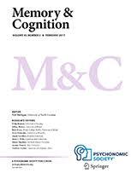
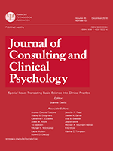
Journal Articles
What are Scholarly Journals?
  Periodical that publishes original research
  Centered around a specific topic within a field

Slide 7

Journal Articles
Articles can take many forms:
  Book reviews
  Theoretical pieces
  Findings from original research

Slide 8

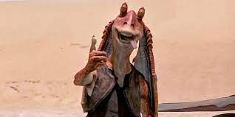

Journal Article Reporting Standards (JARS)
Guidelines for what’s included in a journal article
Many types of articles
  Format will differ depending on an article’s goal
  Example:
    Research article vs. Literature review

Slide 9
Journal Research Articles
Primary Components
  Introduction
    Introduces topic and provides background
  Method
    Details experiments and procedures
  Results
    Reports experimental findings (evidence!)
  Discussion/Conclusion
    Interprets findings and draws conclusions

Slide 10

Research Articles
Introduction:
  Literature review
    What’s already been published on a topic?
  Argument
    Proposes the research question(s). What stance does the author take towards the problem?
    Frames the importance!
  Claim for significance
    Why does the author’s work matter?

Slide 11

Research Articles
Method
  Participants (Human subjects research)
    Who was the sample? How were participants recruited and compensated?
  Materials
    What were the stimuli? (word pairs, pictures of faces, questionnaires, etc.)
  Procedure
    What did the research team do? Step-by-step description of how the experiment was conducted

Slide 12
Research Articles
Results:
  What did the research team find? What evidence supports their claims?
    Statistical analyses are reported here
Discussion:
  How do the researchers interpret their findings?
    Implications? Future research directions? What’s the take-home message?

Slide 13
Literature Reviews
Collects key sources on a topic and discusses how they related to one another
  Process called synthesis
Literature == body of research or scholarship in a field
  “The literature on Schizophrenia”

Slide 14
Literature Reviews – Why?
As part of a research paper
  Introduces the topic in questions
As a stand-alone paper
  Find gaps in the literature (Example: what hasn’t been done yet? What do we still not understand?)

Slide 15
Components of Lit Review
Introduction paragraph
  What is your topic?
  What is your central research question (thesis statement)
  What are the key points you’ll be focusing on?
Body
  Summarize and the synthesize
    What are the main points of each source?
    Interpret! Don’t just paraphrase!
Conclusion
  Summarize key findings
  Tie it back to the research questions

Slide 16
Organizing a Literature Review
Theoretical:
  Have different theories been proposed to explain a phenomena?
  How do they differ? Does one theory hold more weight than the other? What data do you have to support your claim?

Slide 17
Organizing a Literature Review
Chronological:
  Trace the development of a topic overtime
  Don’t just summarize and list sources in order!
  What are the turning points? Key debates? Why does it matter?
Thematic:
  Are their recurring themes in your sources?

Slide 18

Journal Articles
Why do we trust journal articles?
Undergo peer review before they can be published
This process ensures that reported findings are accurate and legitimate.

Slide 19
Peer Review
2-4 independent scholars who review and critique the quality of the article
Are the findings interpreted correctly? Did the authors miss relevant studies in the intro? Have they considered another viewpoint, etc.?
Peer review is rigorous, and articles often undergo several rounds of revision before publication
This process means peer reviewed articles are more trustworthy than other sources (e.g., Wikipedia, google, etc.)

Slide 20
Why not Just use Wikipedia?
Wikipedia is not considered a reliable source
Why?
  Not everything is accurate, comprehensive, or unbiased
Rules of thumb:
  Be wary of any material using only a single source
  Always check reference articles (do they really support what the article says?)

Slide 21

Finding Peer Reviewed Articles
Library? Especially useful for finding old articles
Internet!

Slide 22
Finding Peer Reviewed Articles
Library? Especially useful for finding old articles
Online Library Resources
  https://msutexas.edu/library/ (main library site)
  https://msutexas.edu/library/departments/ill-dept.php (Interlibrary loan)

Slide 23
Finding Peer Reviewed Articles
Other internet resources:
  Google Scholar (https://scholar.google.com/)
  JSTOR (https://www.jstor.org/)

Slide 24
Finding Peer Reviewed Articles
Note: Research articles aren’t always free
  Many journals are subscription based
    Articles locked behind paywalls ☹
    Some journals charge upwards of $40 to access one article
If you come across an article you need and can’t find a free copy, DO NOT PAY MONEY FOR IT!

Slide 25
Finding Peer Reviewed Articles
Things to do instead…
  Request it through interlibrary loan (99% of the time, ILL will be able to freely obtain the article)
  Email the lead author and politely ask for a copy
  Email me as a last resort!

Slide 26
Article Evaluation (1)
What are the researcher’s hypotheses?
What are the independent and dependent variables?
What are the key findings?

Slide 27
Article Evaluation (2)
Do the authors mention any limitations?
What conclusions do the authors draw?
Have other studies found similar results?

Slide 28
Article Evaluation Tips (1)
Don’t read them straight through!
  Why? Time!
Be deliberate with your reading!
Do read:
  The Abstract
  Figures and Tables
  Introduction
  Discussion/Conclusion
Skim:
  Methods
  Results

Slide 29
What to Read First?
Read the abstract!
  This will let you decide whether or not an article is a good source to use on your paper

Slide 30



What is an Abstract Anyways?
Brief summary of a research study.
Most journal websites let you preview the abstract before downloading an article

Slide 31
What Makes a Good Abstract?
States the purpose of the study (usually the first sentence)
Summarizes key findings
How are the results interpreted?
From this information, you’ll be able to determine whether the article you found would make a good source for your paper.

Slide 32
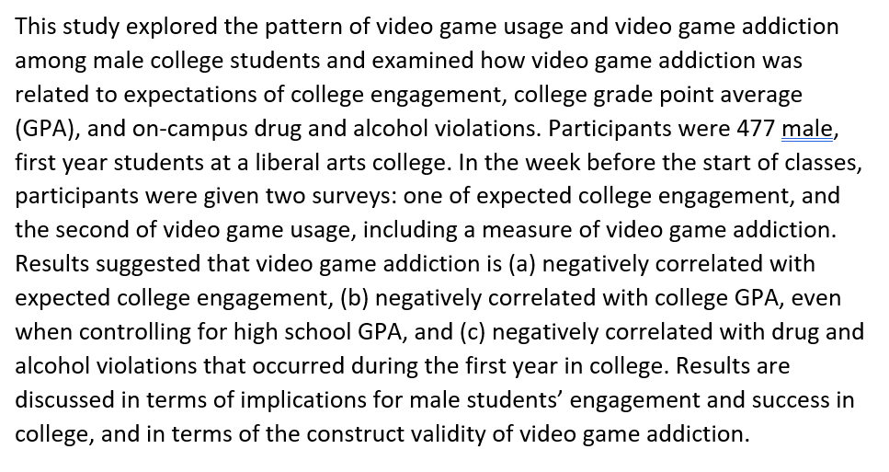
Abstract Example 1: Study on Video Game Addiction

Slide 33
Abstract Example 2: Advertising and Children

Slide 34
Abstract Example 3: Social Media and Body Image

Slide 35
Article Evaluation Tips (2)
As you read the abstract ask yourself….
  What topic is the researcher focused on?
  What are their key findings?
  Does this seem related to my topic?
As you read the introduction:
  How does this study differ from previous work?
  What specific problem are the researchers trying to address?

Slide 36
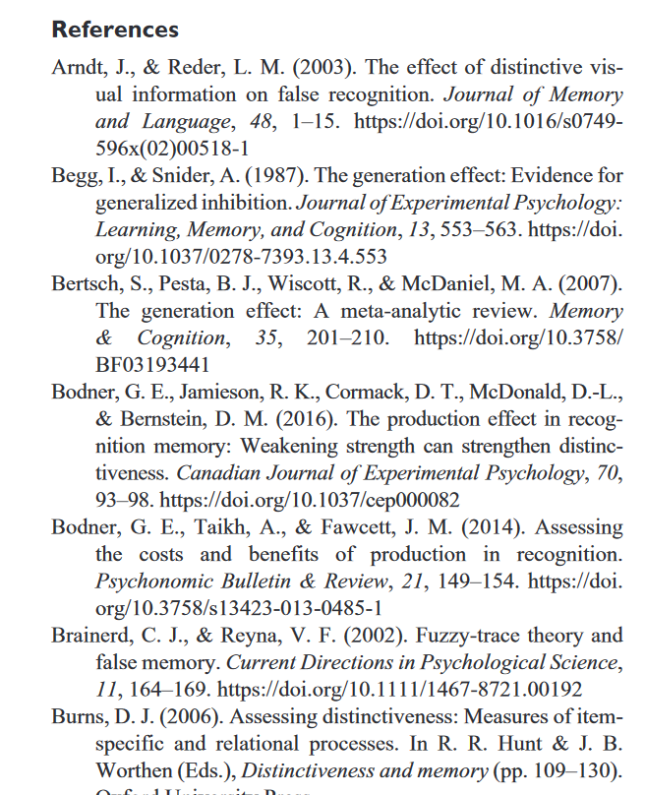
Article Evaluation Tips (3)
Use the reference section to find more sources!
Super easy to do this by searching google scholar!
https://scholar.google.com/

Slide 37
Staying Organized
Save articles as you come across them. Give them helpful names
  Use the AUTHOR YEAR format when saving files
  Example: “Maxwell Huff 2022.pdf”
Keep a running list of sources.
  Helpful when making your final reference page

Slide 38
Questions???

